Slide 1

Estimating GOOG Options Value through the CRR Model
Metodi Probabilistici e Statistici per i Mercati Finanziari
Università degli Studi di Roma Tor Vergata
Danilo D’Amico
0320389

Slide 2
Index
Introduction
GOOG stock insights
Risk-free rate
Estimate
CRR model
Introduction
Price tree generation
Call values
Put values
Put-call relationship
European put-call parity
American put-call inequality
Aim
Algorithm
Parameters calibration
Backwards computation

Slide 3

Introduction - aim
This project seeks to predict the future values of call and put options for the GOOG stock (Google Inc./Alphabet) using the CRR model.
The forecasts assume that the date is August 10, 2023, with options expiring on September 8, 2023 (20 trading days)

Slide 4
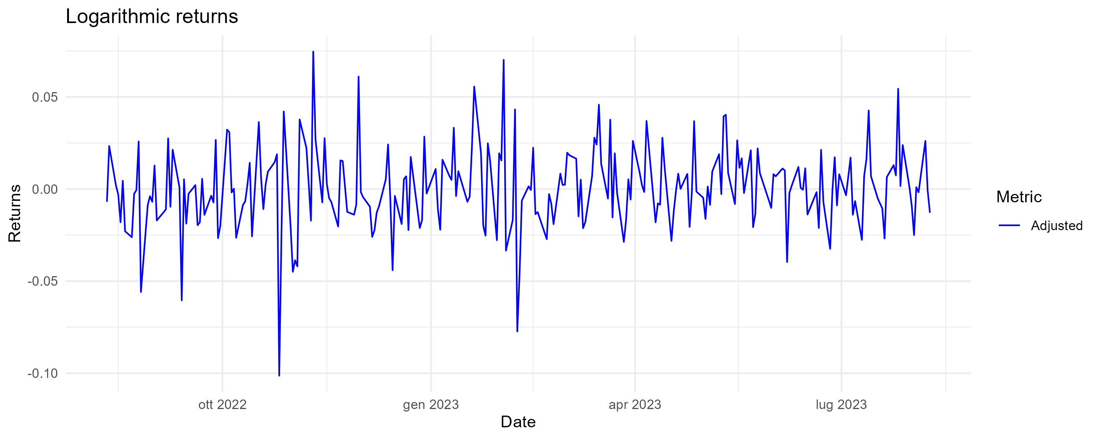
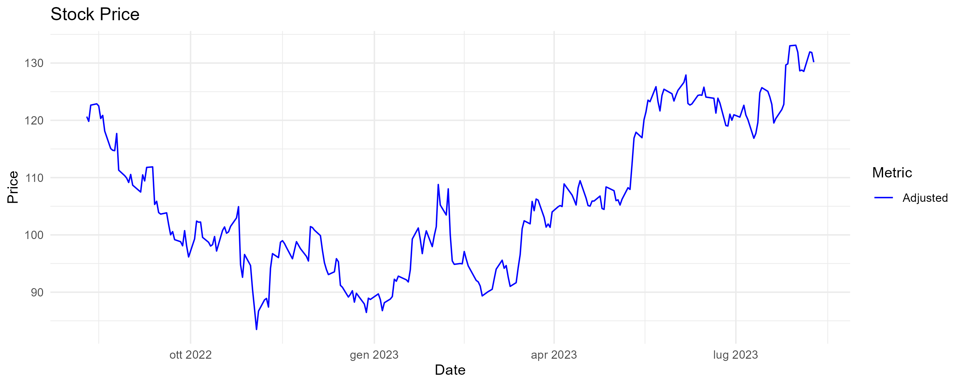
Introduction - GOOG stock insights
The charts display the stock price and logarithmic returns of GOOG from August 10, 2022, to August 10, 2023
The low volatility (σ) can be attributed to the nature of the underlying asset. It is equal to 0.02242869

Slide 5
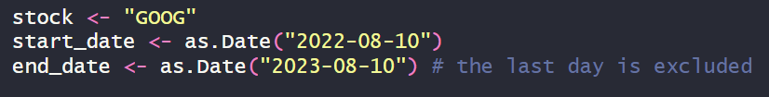
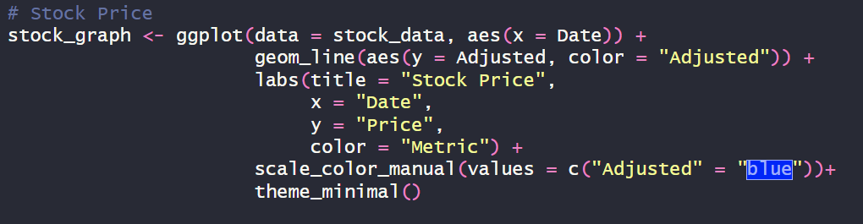
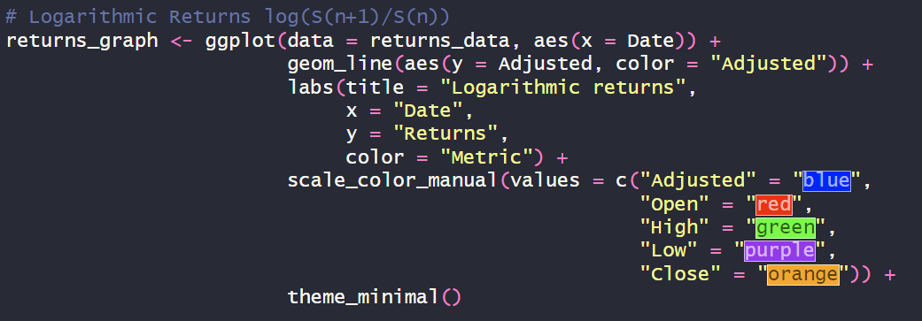
Introduction - code snippets

Slide 6
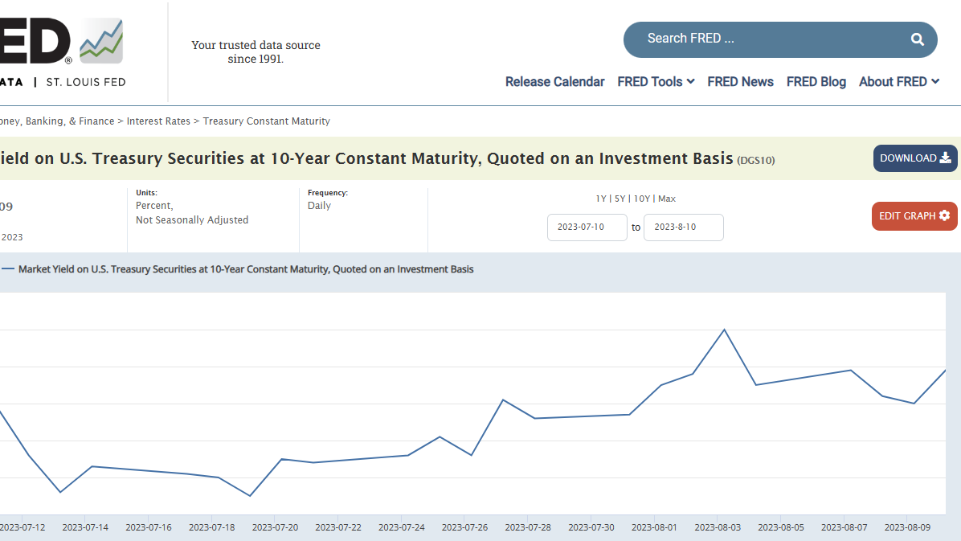

Risk-free rate – estimate
Real risk-free rate $=$ nominal risk-free rate – rate of inflation
We computed the nominal risk-free rate using U.S. Treasuries as a reference. The data was sourced from the Federal Reserve Bank of St. Louis.
Originally, we intended to use the market yield on U.S. Treasury securities with a 1-month constant maturity starting from August 8, 2023 (DGS1MO). However, due to challenges in adapting this value to the rapidly changing inflation rate, we opted for the 10-year Treasury constant maturity rate (DGS10) instead.
The inflation rate for the U.S. in 2023 (0.037) was estimated based on data from the financial investment firm Morningstar.

Slide 7
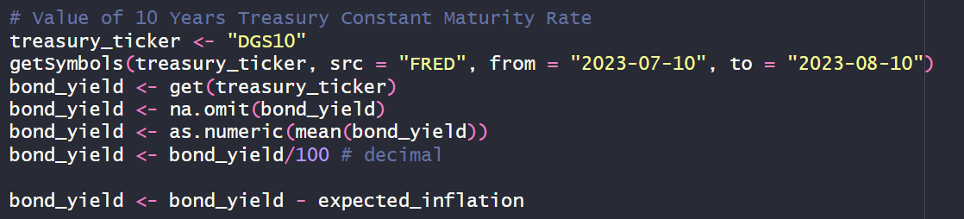
Risk-free rate – code snippets

Slide 8
CRR model - introduction
Multiperiod model. At the end of each period, the operator refinances their portfolio until the last period when they liquidate it.
The study of GOOG options can be considered as the study of a self-financing portfolio without bonds and with only one stock (the call or put derivative in question).
Assumptions:
Equal Borrowing and Lending Rates
Fractional Bond and Stock Trading
Zero Transaction Costs
Short Selling Allowed
No Dividends

Slide 9
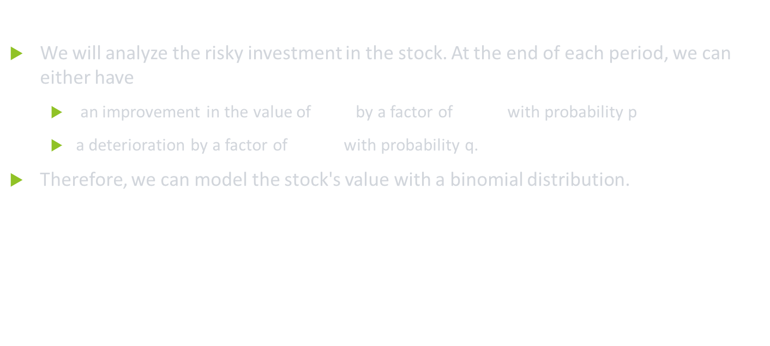
CRR model - introduction
We will analyze the risky investment in the stock. At the end of each period, we can either have
an improvement in the value of $S_{n−1}$by a factor of ${uS}_{n−1}$with probability p
a deterioration by a factor of ${dS}_{n−1}$ with probability q.
Therefore, we can model the stock's value with a binomial distribution.
$$S_{n}=\left\{\begin{aligned}uS_{n−1} P\left(S_{n}=uS_{n−1}\right)=p \\ dS_{n−1} P\left(S_{n}=dS_{n−1}\right)=q\end{aligned}\right.$$

Slide 10
CRR model - algorithm
Price tree generation
Option value at final nodes
$$Call:{max⁡(S}_{n}−K,0)$$
𝐶𝑎𝑙𝑙:〖max⁡(𝑆〗_𝑛−𝐾,0)
Backwards computation
${value\left[i,j\right]=e}^{−r∆t}$(p̃*$value\left[i+1,j+1\right] +$q̃*$value\left[i+1,j\right])$
〖𝑣𝑎𝑙𝑢𝑒[𝑖,𝑗]=𝑒〗^(−𝑟∆𝑡)(p̃*𝑣𝑎𝑙𝑢𝑒[𝑖+1,𝑗+1] +q̃*𝑣𝑎𝑙𝑢𝑒[𝑖+1,𝑗])
$Put:max⁡(K−S_{n},0)$
𝑃𝑢𝑡:max⁡(𝐾−𝑆_𝑛,0)

Slide 11

CRR model – parameters calibration
$N=20$
Represents the number of periods considered. 20 is the number of trading days between August 10, 2023 and September 8, 2023.
$∆t=\frac{T}{N}=1$
Number of trading periods to the expiration date divided by the numbers of periods considered. They coincide, meaning one day in a trading year.
$u=e^{σ√∆\text{t}}$
Up factor.
$d=\frac{1}{u}$
Down factor.
$\text{p}\text{̃}=\frac{1+r−d}{u−d}$, $\text{q}\text{̃}=\text{1}\text{−}\text{p}\text{̃}$
Risk-neutral probability

Slide 12
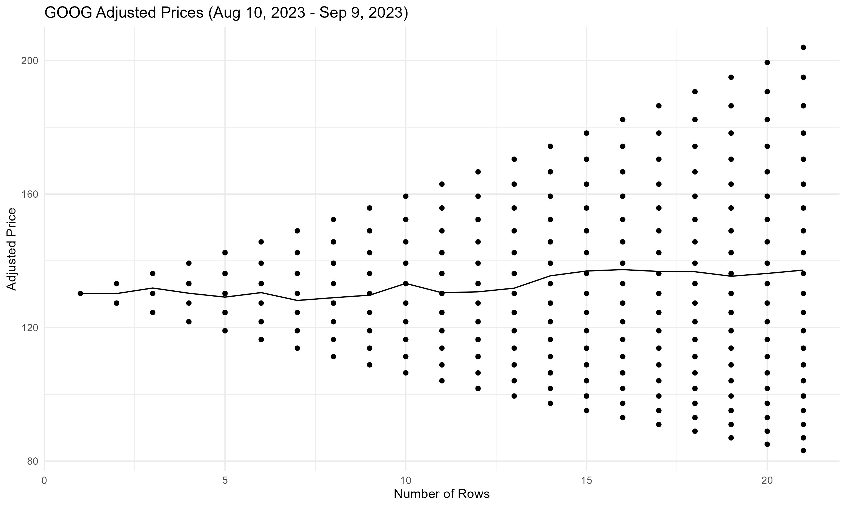
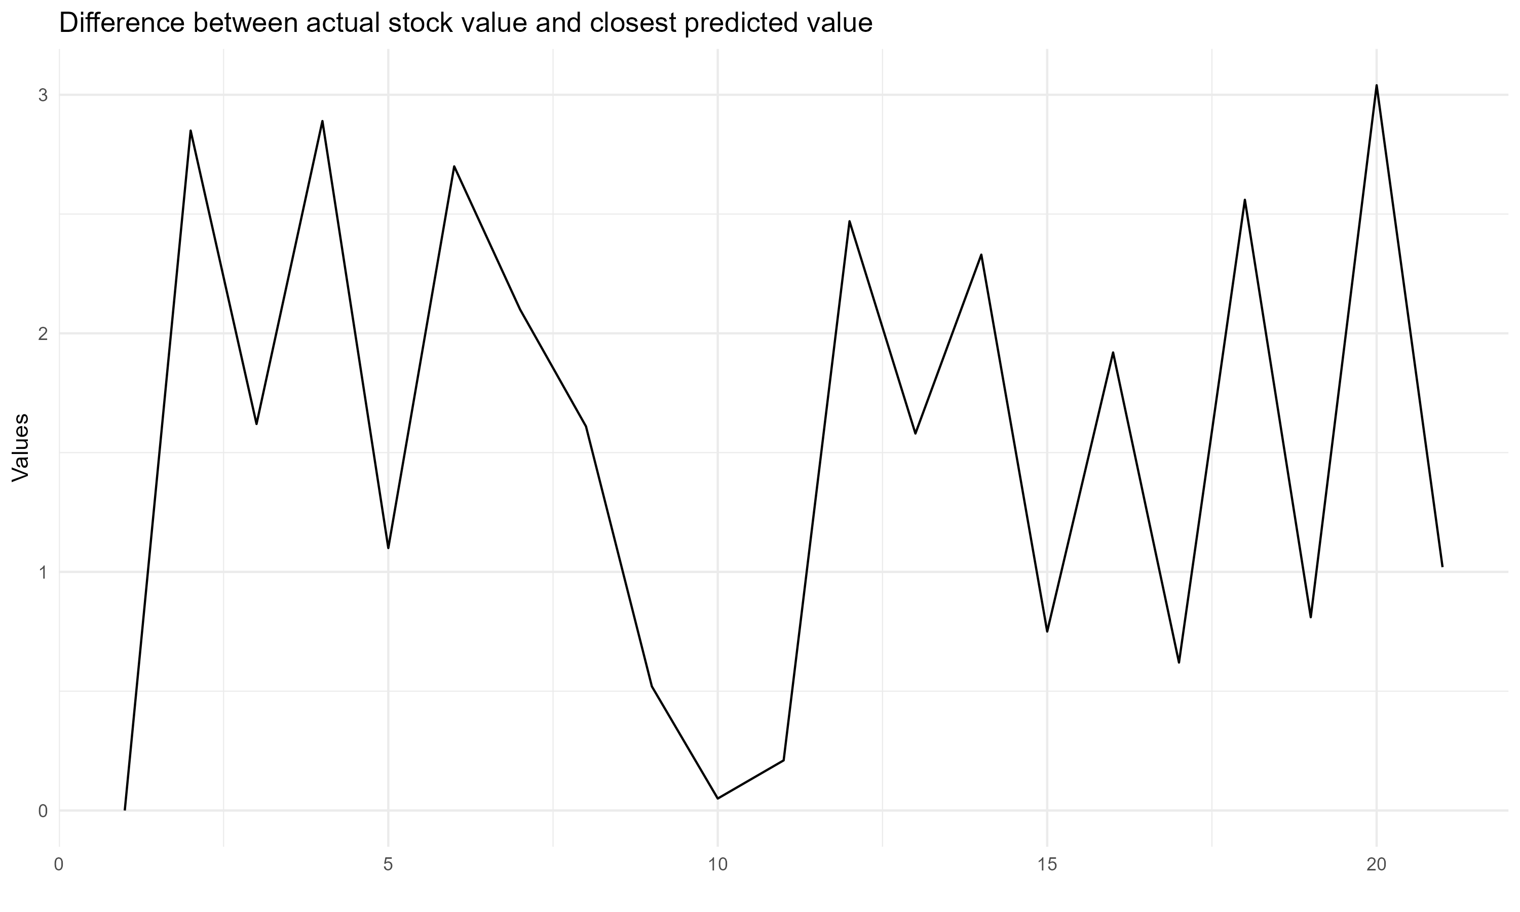
CRR model – price tree generation
Difference between predicted and actual stock value:
Min = 0.05000671
Max = 3.039997
Average = 1.637498

Slide 13

CRR model – backwards computation
Under the risk neutrality assumption, today's fair price of a derivative is equal to the expected value of its future payoff discounted by the risk free rate.
Therefore, expected value is calculated using the option values from the later two nodes (Option up and Option down) weighted by their respective probabilities.
The expected value is then discounted at r, the risk free rate corresponding to the life of the option.
${value\left[i,j\right]=e}^{−r∆t}$(p̃*$value\left[i+1,j+1\right] +$q̃*$value\left[i+1,j\right])$

Slide 14
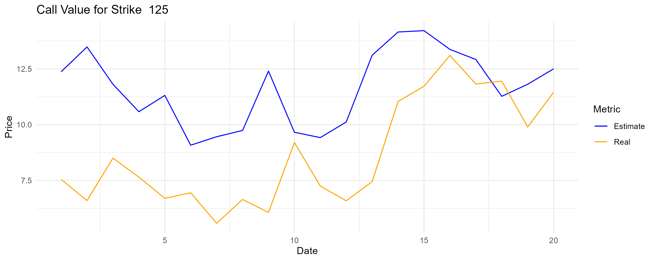
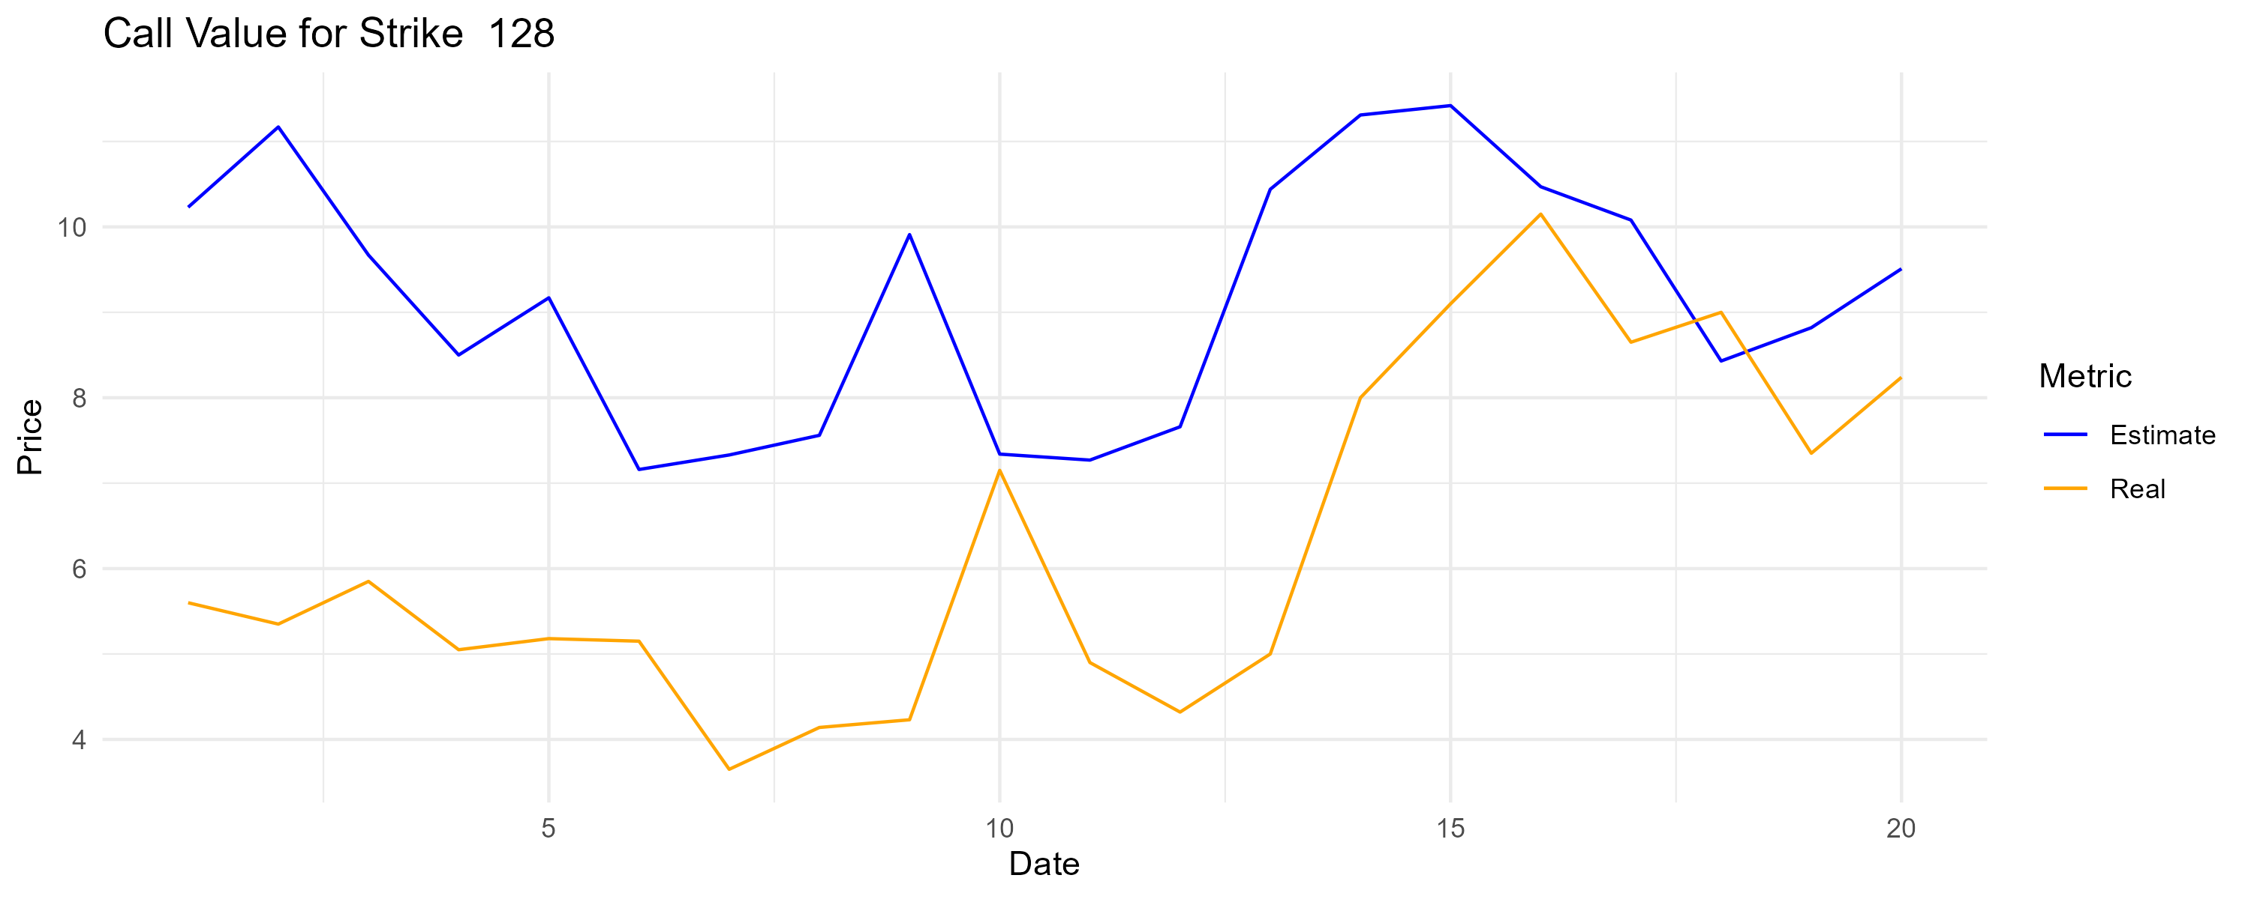
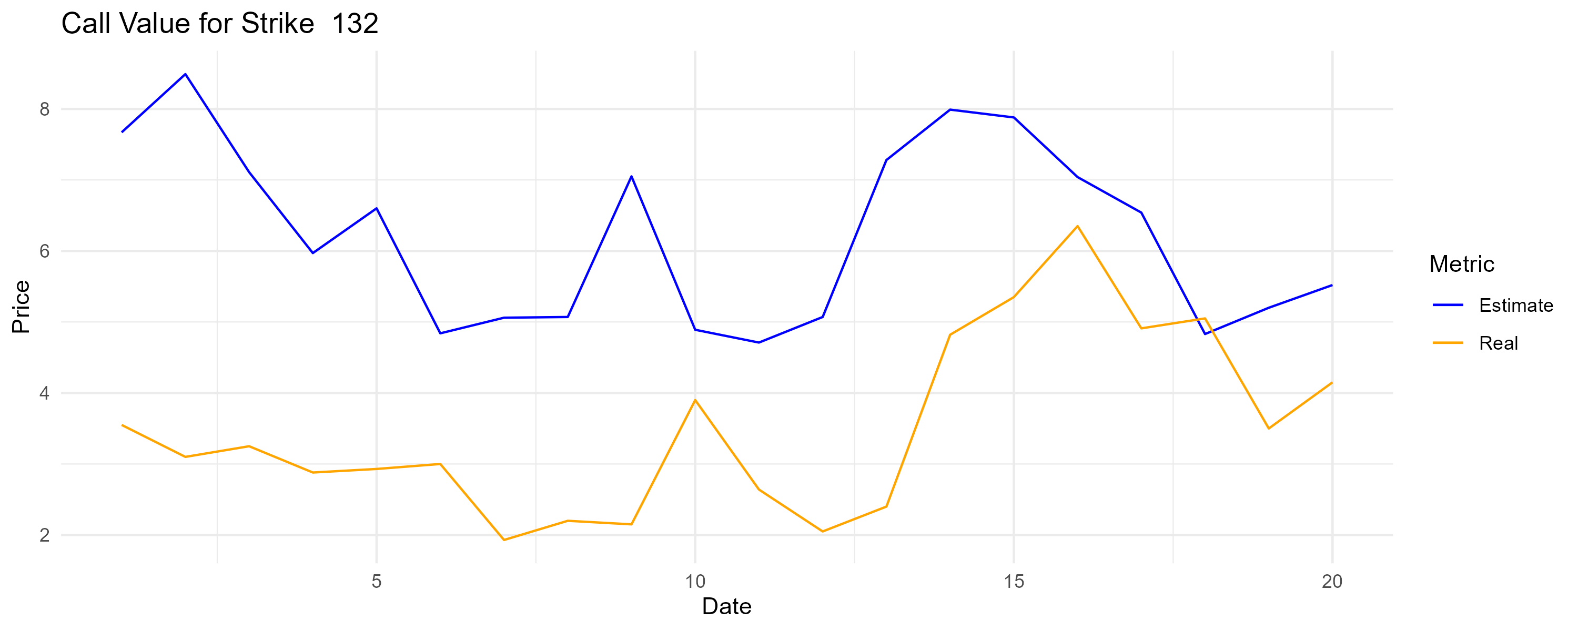
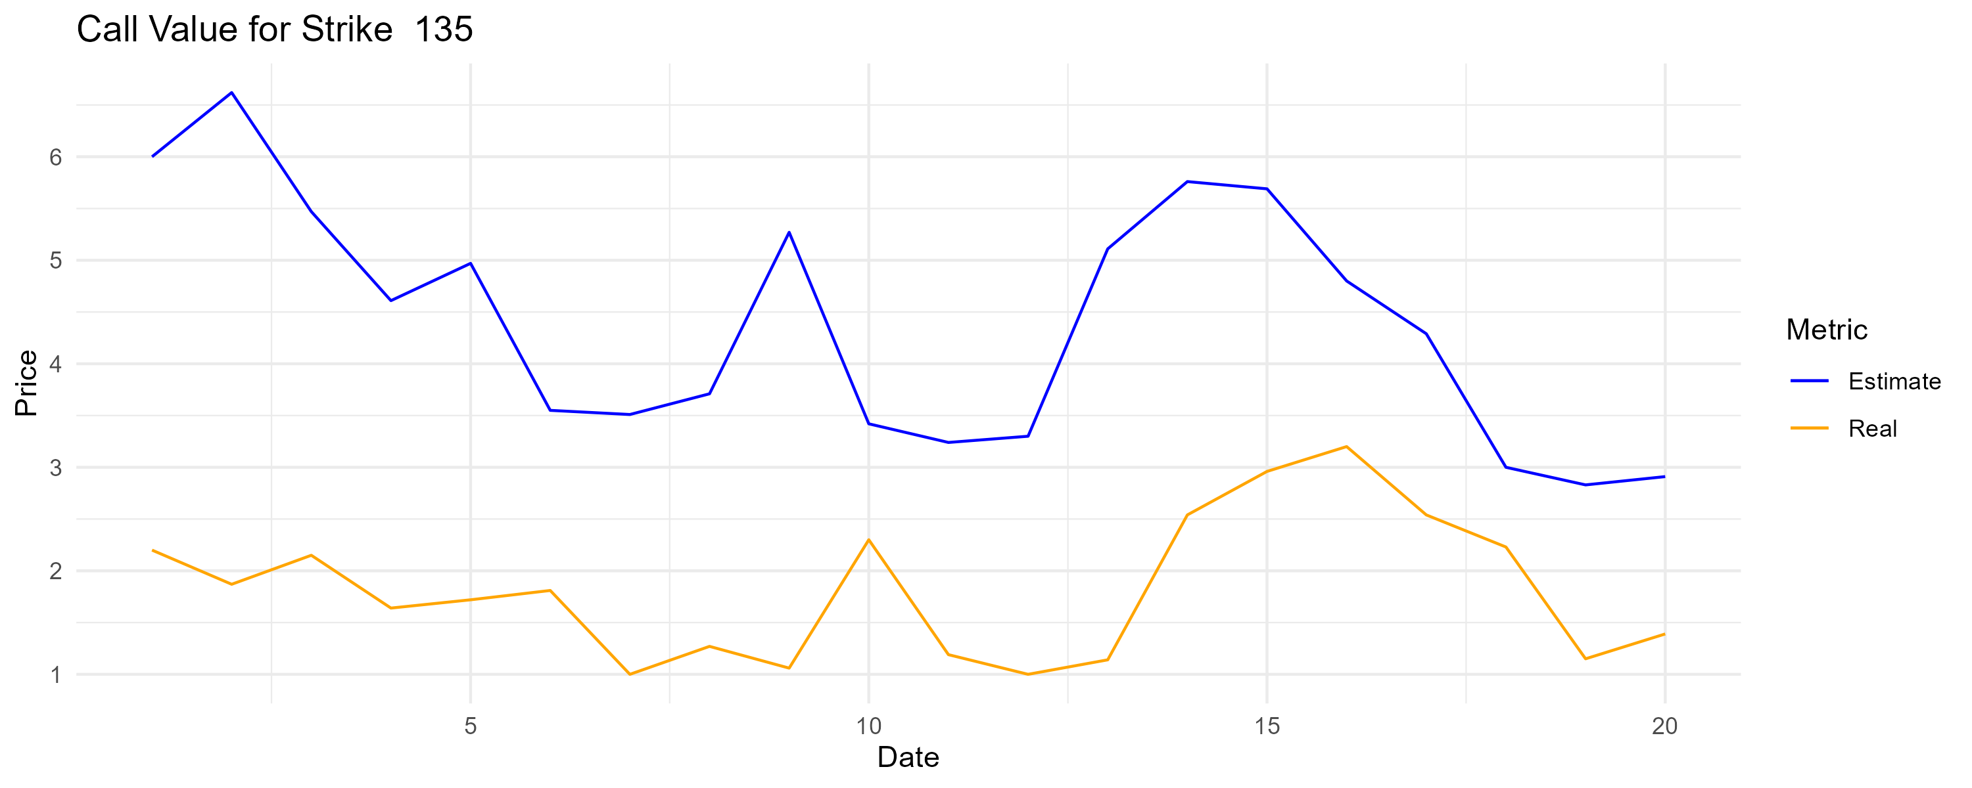
CRR model – call values

Slide 15
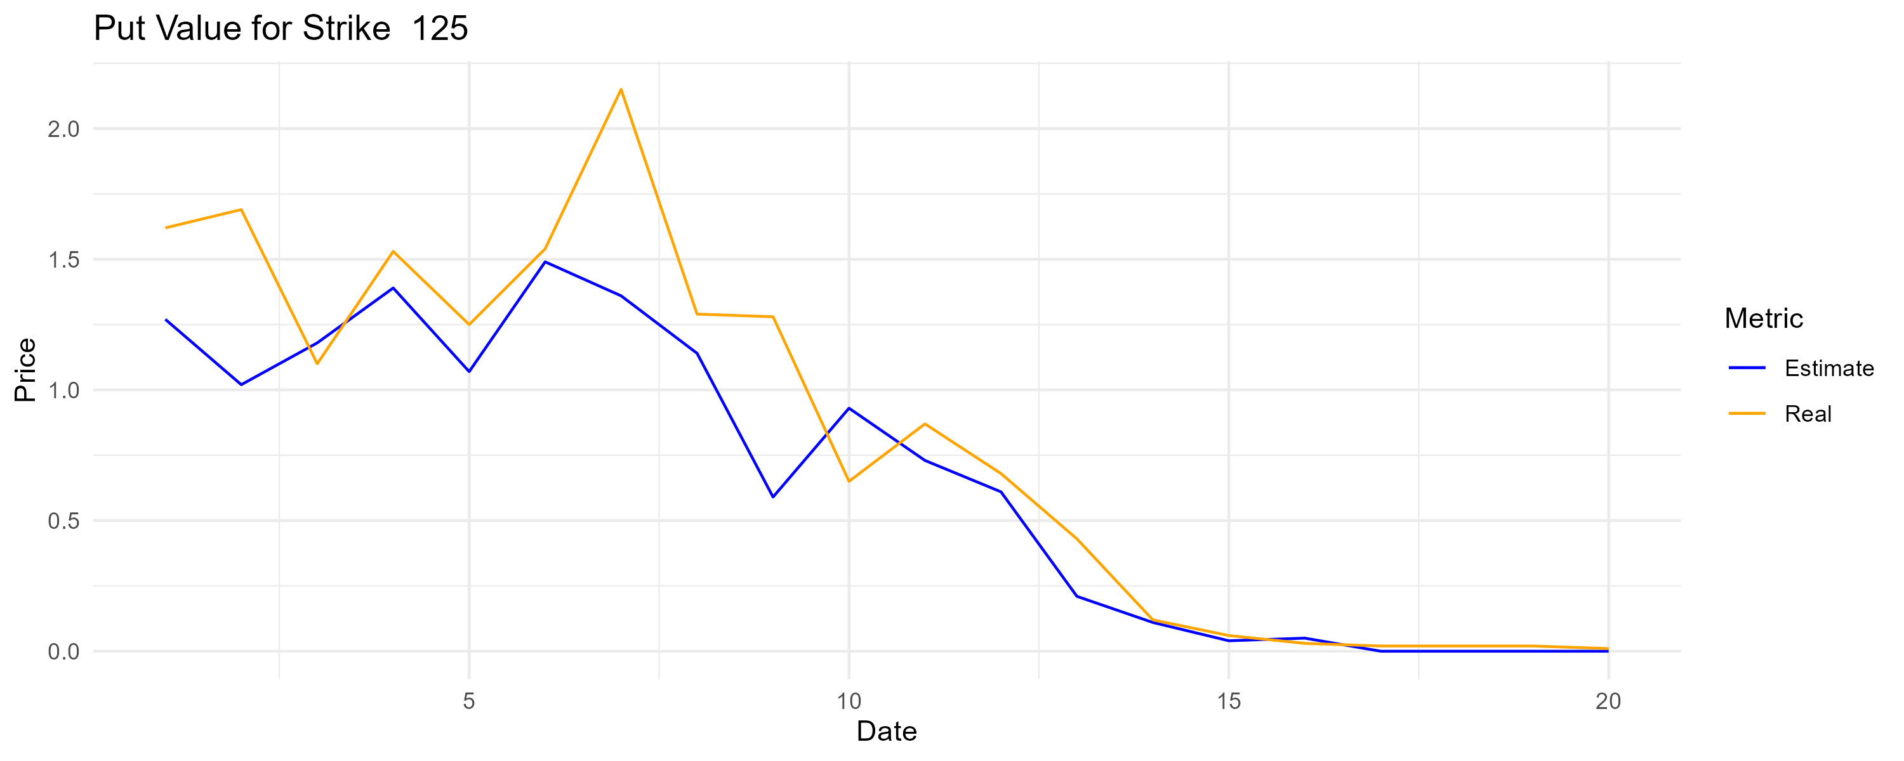
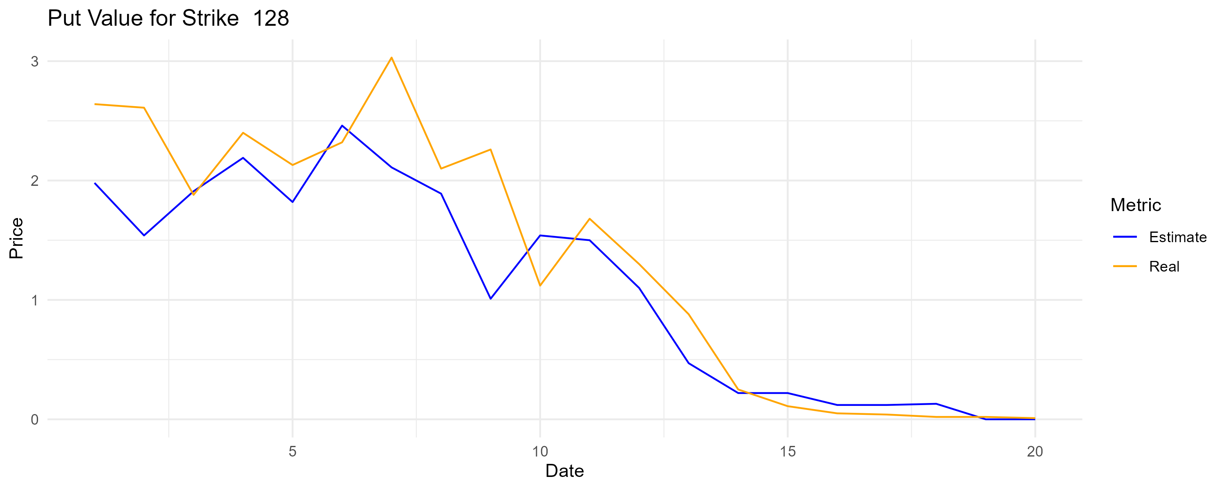
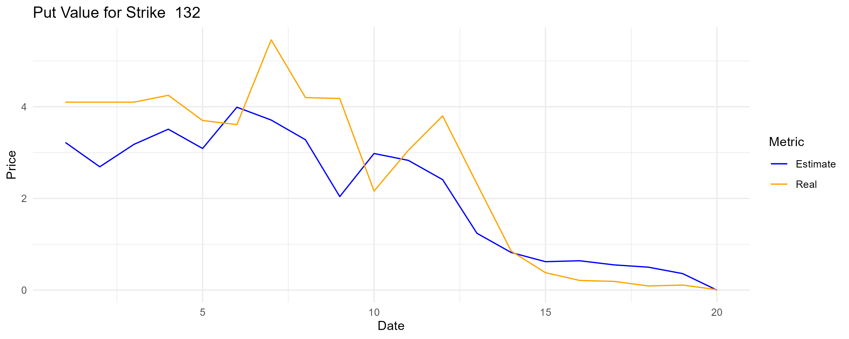
CRR model – put values

Slide 16
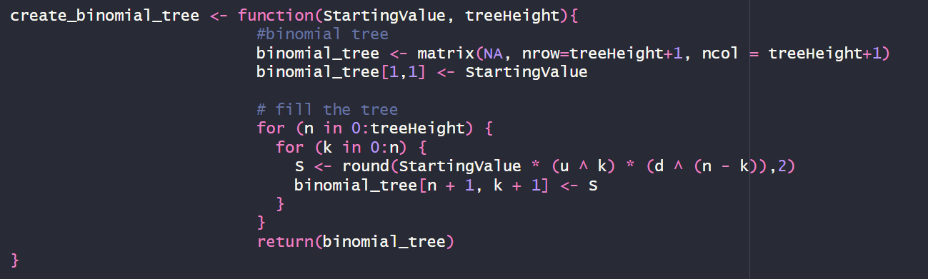
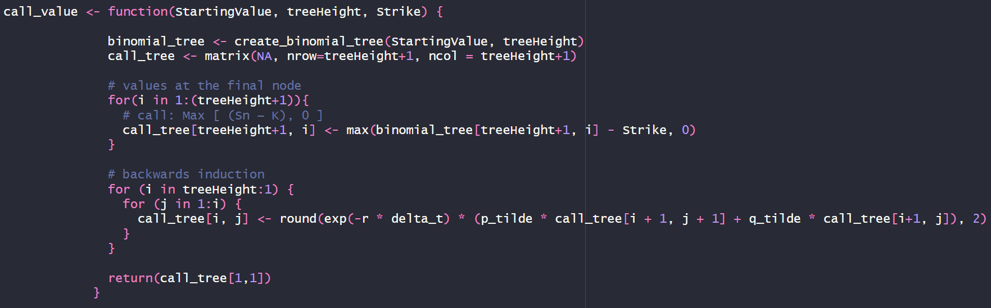
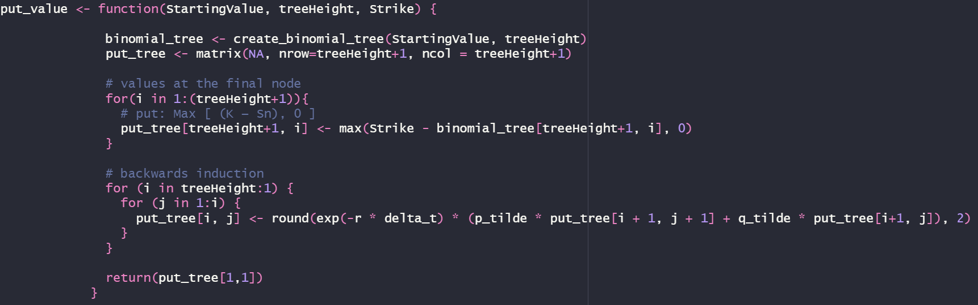
CRR model – code snippets

Slide 17
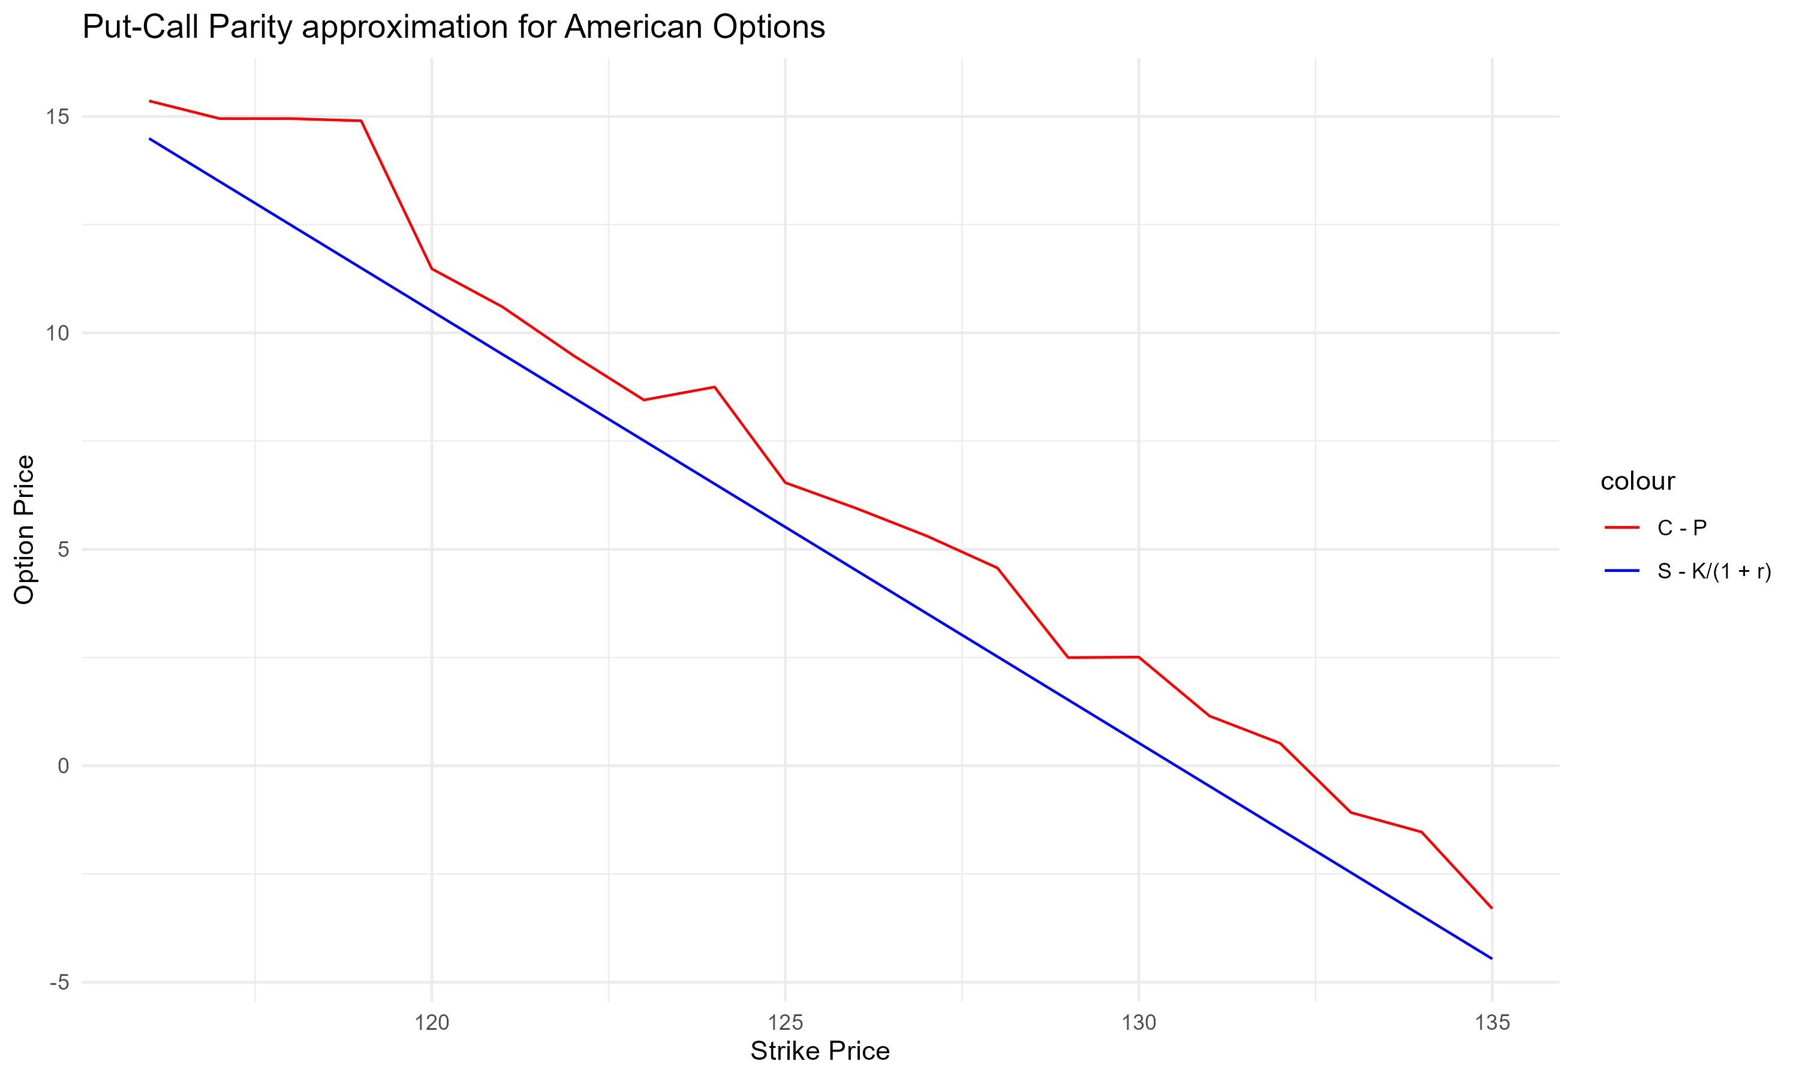

Put-call relationship – european put-call parity
$C_{0}−P_{0}=$ $S_{0}$ $−\frac{K}{1+r}$

Slide 18
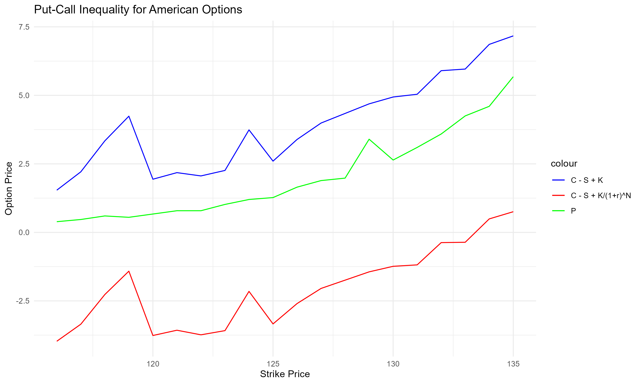

Put-call parity – american put-call inequality
$AC_{0}−S_{0}+K≥$ ${AP}_{0}≥AC_{0}+\frac{K}{{(1+r)}^{N}}−S_{0}$

Slide 19
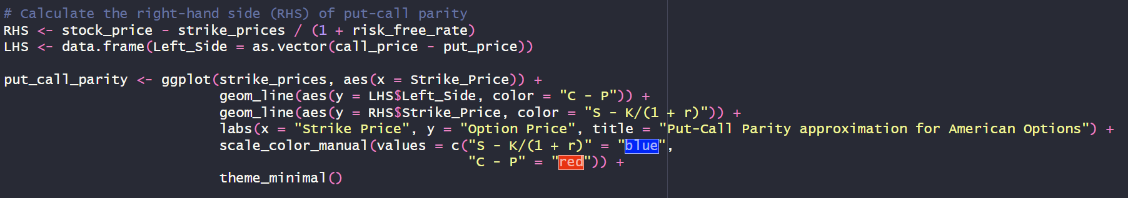
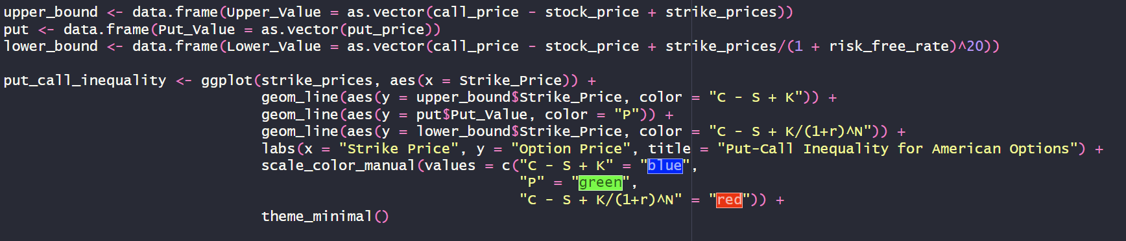
Put-call parity – code snippets

Slide 20

Links
GitHub repository: https://github.com/DaniloDamico/GOOGOptionsStudy

